Slide 1



Investigating the Performance and Reliability, of the Q-Learning Algorithm in Various Unknown Environments
Amirhossein Nourian, Dr. Majid Sadedel
Fall, 2023
Generated by DALL-E3

Slide 2
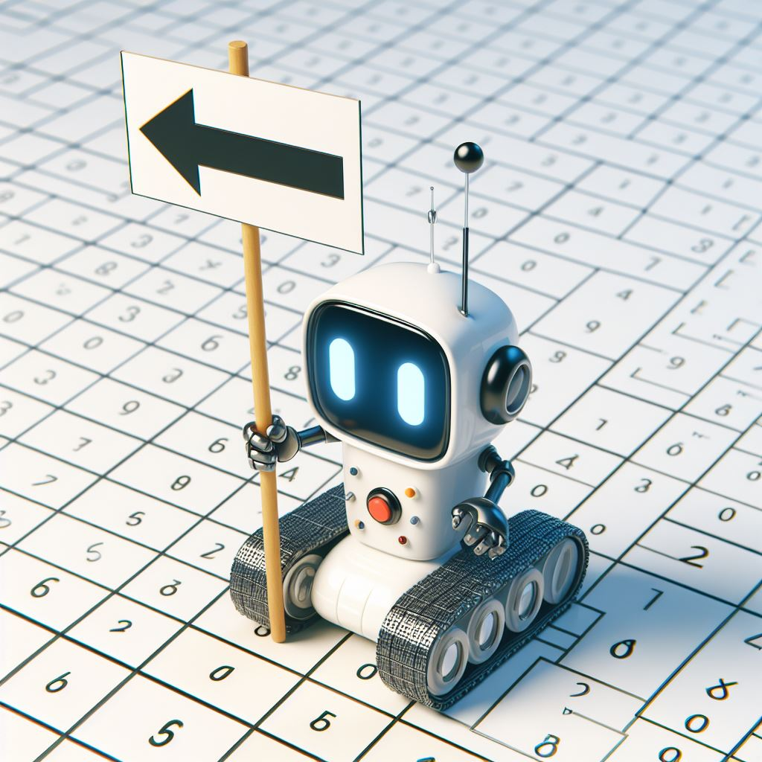
Table of Contents:
1- Overview
2- Motivation
3- Implementation
4- Results
5- Future Works
Generated by DALL-E3
0/11
Notes:
The objective is to enhance our understanding of the algorithm’s efficacy and reliability across a range of unexplored environments.

Slide 3

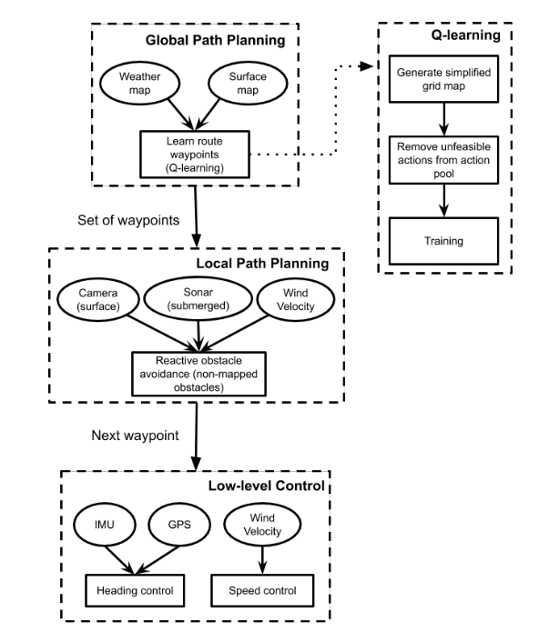
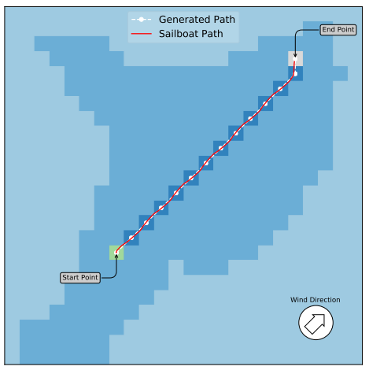
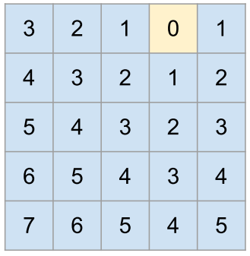
1- Overview
Creation of the image that will be used to generate the blocks matrix.
1- Overview
2- Motivation
3- Implementation
4- Results
5- Future Works
Data flow chart of high level path planning for sail boat
Policy Evaluation
Calculating Q-Table
1/11
Notes:
In a multitude of robotic applications, three hierarchical planning and control strategies are commonly employed. At the foundational level, local path planning and low-level control mechanisms are utilized. These are complemented by a high-level global path-planning strategy, which incorporates a diverse array of environmental information.
Addressing such a path-planning problem necessitates the application of various algorithms, one of which is Q-learning. To effectively employ the Q-Learning algorithm, it is imperative to first transform our two-dimensional map data into a grid world format, subsequently enabling us to solve the problem in a structured manner.

Slide 4
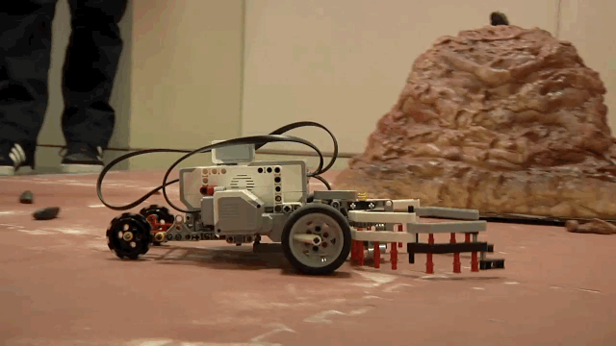
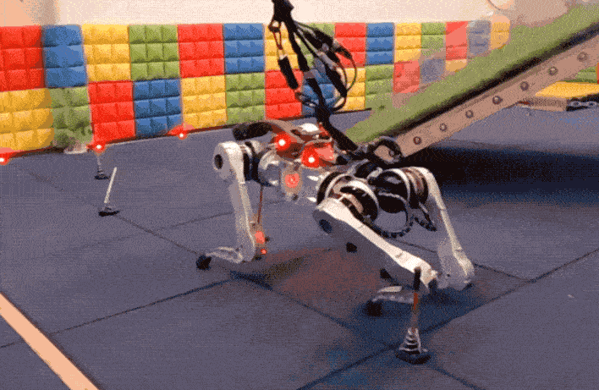
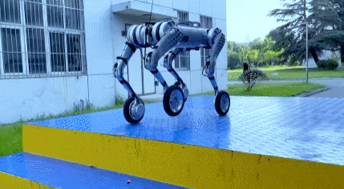
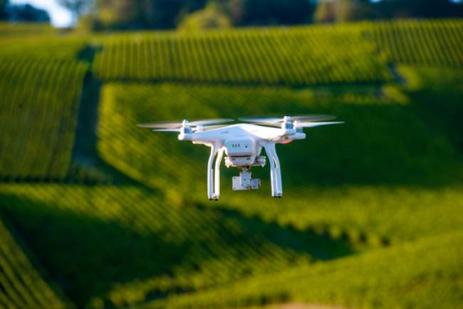
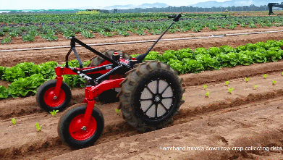
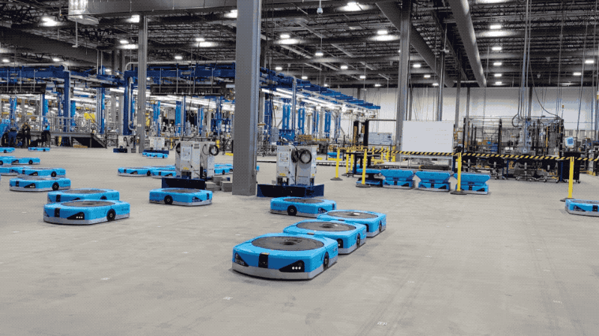
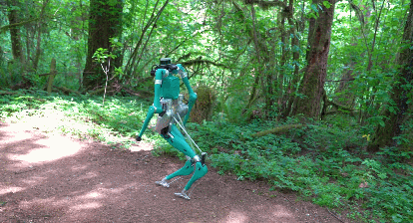
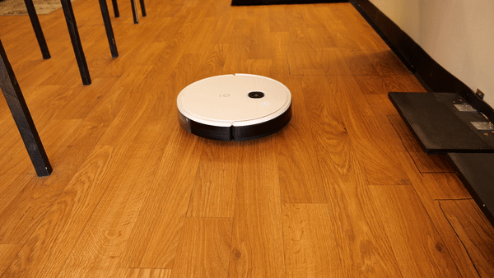
1- Overview
Various Type of Robots
1- Overview
2- Motivation
3- Implementation
4- Results
5- Future Works
Wheeled Mobile Robots
legged Robots
Wheeled Legged Robots
Flying Robots
Different Tasks
Farming
Warehousing
Exploring/Inspecting
Cleaner
Different Unknown Working Environment
2/11
Notes:
No matter what kind of robot we have - it could walk, roll, or even fly - the most important thing about a 2D map is its job. For example, a farming robot might come across random obstacles. A robot working in a jungle might face a more complex 2D world with lots of obstacles. A robot working indoors, like in a house, might face maze-like obstacles, which are the toughest. The key point here is that we can show all these situations in certain grid worlds and study each one.

Slide 5
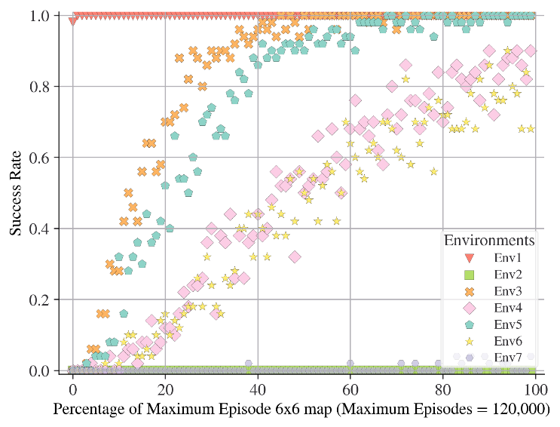
2- Motivation
Convergence
Reliability
1- Overview
2- Motivation
3- Implementation
4- Results
5- Future Works
Grid Size
Map Characteristics
Hyper Parameters
Number of Goal and Obstacles
3/11
Notes:
It’s key to grasp the link between how quickly we learn (convergence rate) and how dependable our solutions are when we use Q-Learning to solve a 2D grid world problem. There are several main factors that affect these:
Grid Size: The size of the grid can influence how fast and how reliably we can find a solution.
Map Type: The kind of map, which is based on the robot’s job, also matters.
Hyperparameters: The settings we choose for the Q-Learning algorithm can have a big impact on how well it works.
Number of Goals and Obstacles: The amount and location of goals and obstacles in the grid world can make the problem harder to solve.
By looking at these factors, we can get a better idea of how Q-Learning performs in different situations.

Slide 6
2- Motivation
1- Overview
2- Motivation
3- Implementation
4- Results
5- Future Works
4/11
Notes:
To figure out how much each factor affects the speed of learning and the trustworthiness of the solutions, we created some 2D grid models for each robot task. We then turned these into 2D grid world scenarios. By solving these scenarios, we could measure the speed of learning, the trustworthiness of the solutions, and see which factors had the most impact for each one.

Slide 7
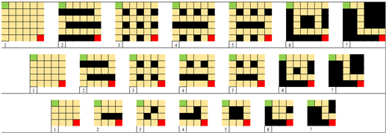
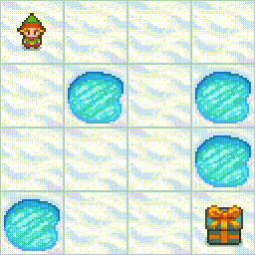
3- Implementation
Environment Modeling
1- Overview
2- Motivation
3- Implementation
4- Results
5- Future Works
4x4, 5x5, 6x6 Maps
Frozen Lake Environment
5/11
Notes:
Here’s how we change each situation. For example, we might change a farming robot scenario to one with no obstacles, or a jungle robot scenario to one with more obstacles. We also create maps for these situations with different grid sizes, like 4x4, 5x5, and 6x6.
Finally, we put all the maps and situations into the OpenAI frozen lake environment. This environment has small lakes as holes and one goal.

Slide 8
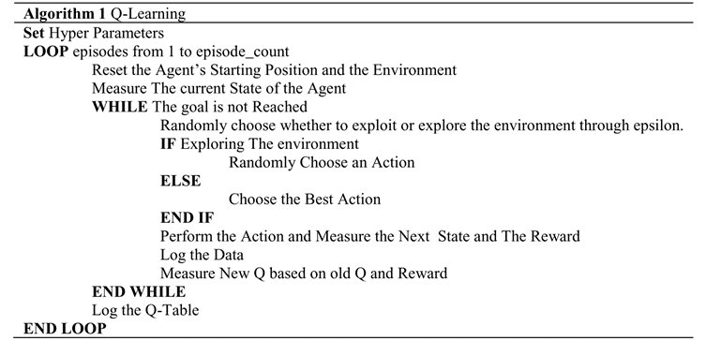
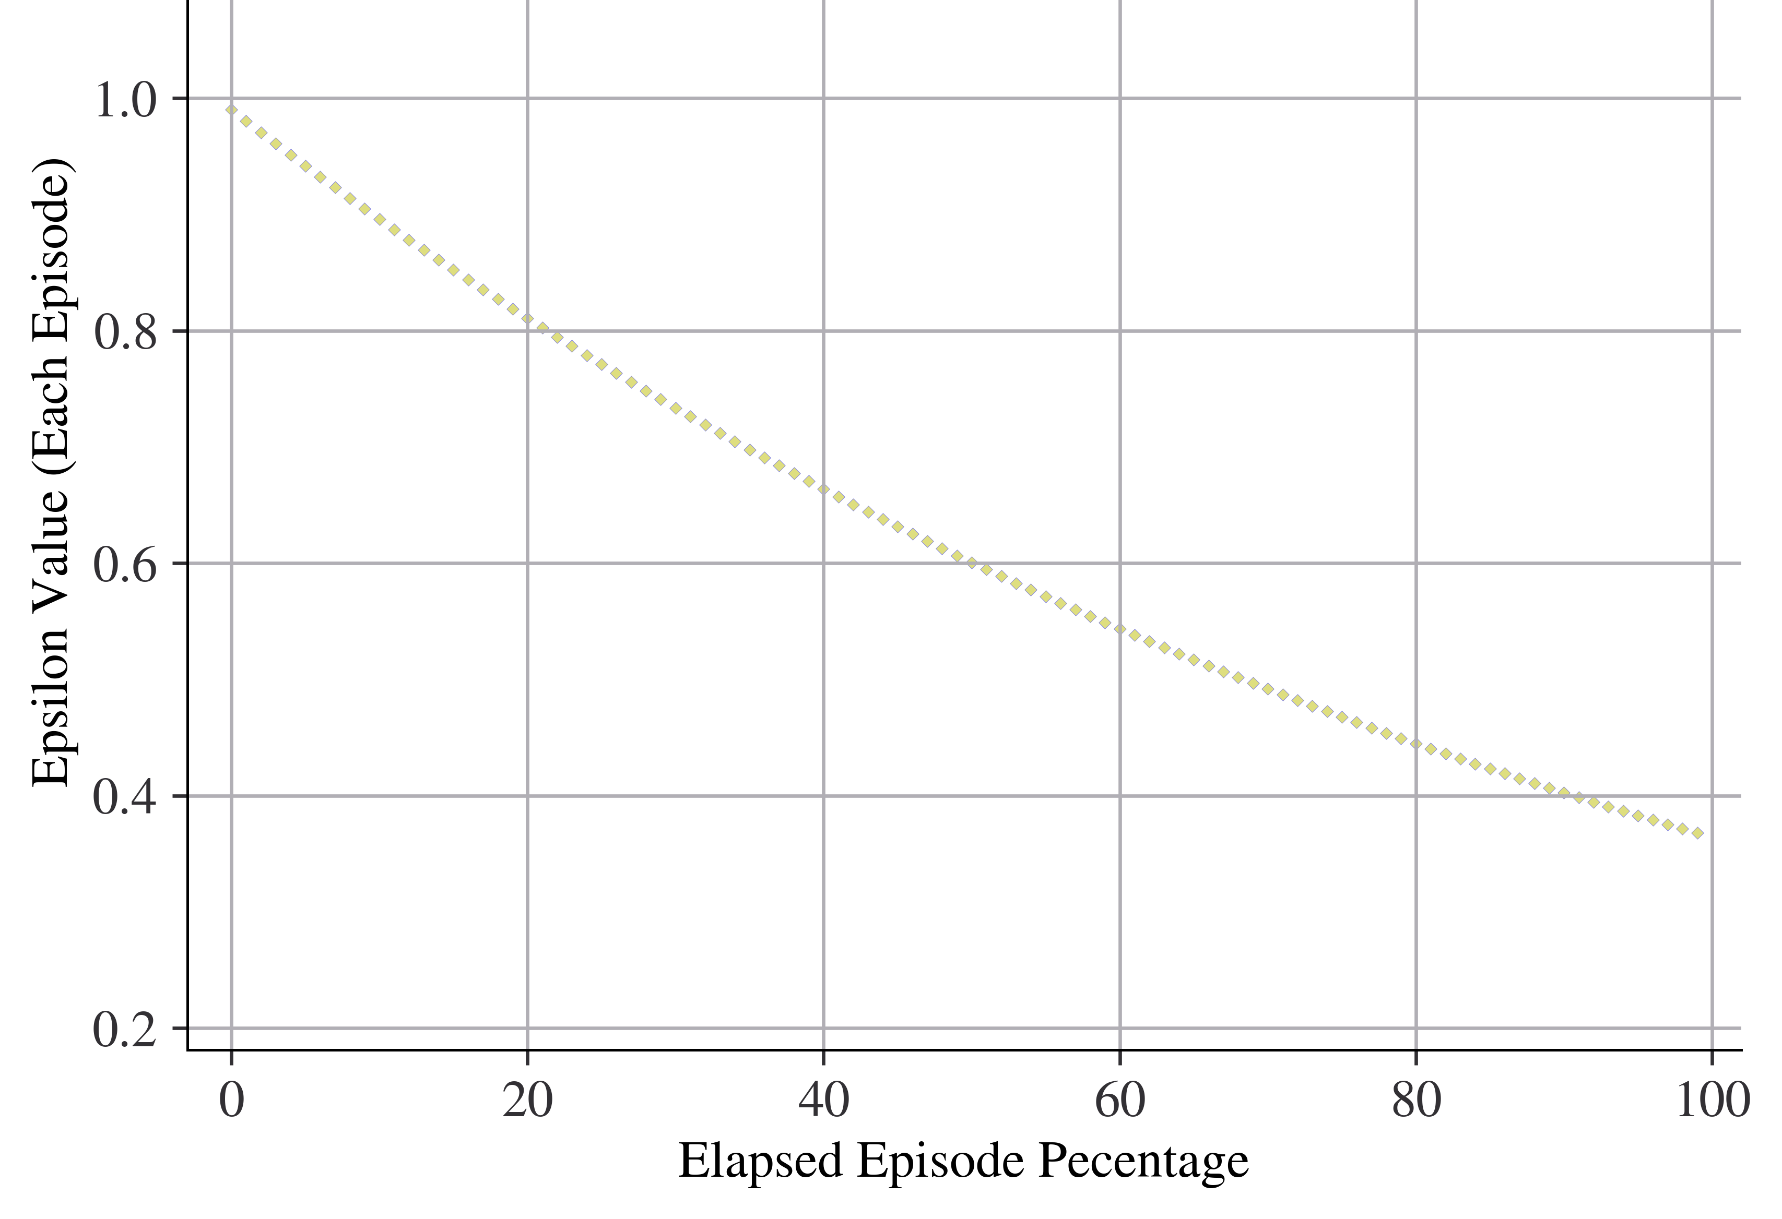
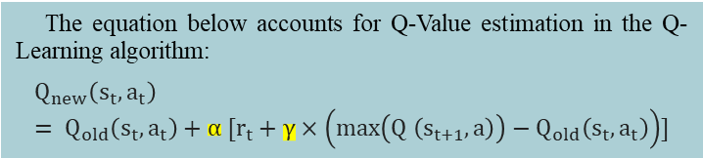
3- Implementation
Q-Learning Algorithm
The equation below accounts for Q-Value estimation in the Q-Learning algorithm:
$$Q_{new}\left(s_{t},a_{t}\right)= Q_{old}\left(s_{t},a_{t}\right)+α [r_{t}+γ×\left(\max\left(Q \left(s_{t+1},a\right)\right)−Q_{old}\left(s_{t},a_{t}\right)\right)]$$
1- Overview
2- Motivation
3- Implementation
4- Results
5- Future Works
Hyper Parameters
Hyper Parameter | Value
α (the learning rate) | 0.9
γ (discount factor) | 0.95
ε (ratio of exploration to exploitation) | Decaying Value (0.9 to 0.3)
6/11
Notes:
As we mentioned before, hyperparameters play a big role too. We keep the hyperparameters alpha and gamma, which are used in estimating Q-values, as fixed values. We also have epsilon-greedy, which affects how greedy the agent is. This is represented by a graph that gets smaller over time. This means that for each episode, the agent will follow this decreasing pattern.

Slide 9
3- Implementation
1- Overview
2- Motivation
3- Implementation
4- Results
5- Future Works
Success Evaluation Approach
7/11
Notes:
To figure out how reliable Q-Learning is in each situation, we look at a set of episodes. We pick a few episodes from this set and see how many times we were successful.

Slide 10
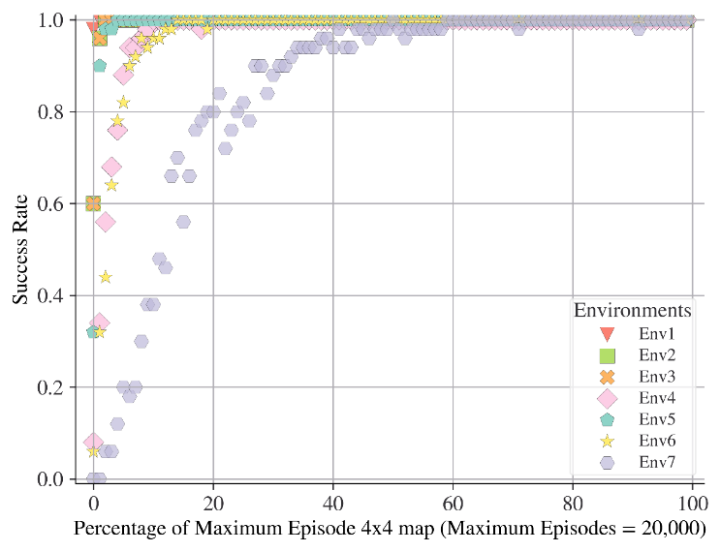
4- Results
4x4 map 20K
Characteristics of Environment | Impact | considerations
Path width | Low to Medium | largely dependent on other characteristics
Number of Routes to Goal | Low to Medium | Unusual barriers could affect the impact
Length of Routs | Medium to High | The cost of calculation increases exponentially with the number of cells.
1- Overview
2- Motivation
3- Implementation
4- Results
5- Future Works
8/11

Slide 11
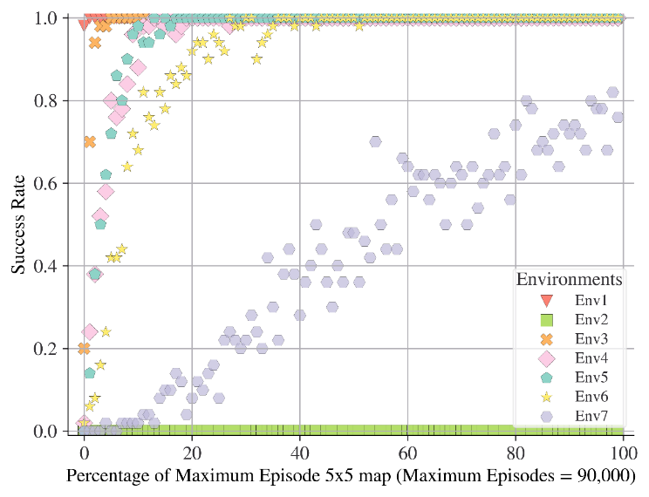
4- Results
4x4 map 20K
5x5 map 90K
Characteristics of Environment | Impact | considerations
Path width | Low to Medium | largely dependent on other characteristics
Number of Routes to Goal | Low to Medium | Unusual barriers could affect the impact
Length of Routs | Medium to High | The cost of calculation increases exponentially with the number of cells.
Grid number of Cells | High | The cost of calculation increases exponentially with the number of cells.
1- Overview
2- Motivation
3- Implementation
4- Results
5- Future Works
Different Unknown Environments Factors and their impact on the performance and reliability
9/11

Slide 12
4- Results
4x4 map 20K
5x5 map 90K
6x6 map 120K
1- Overview
2- Motivation
3- Implementation
4- Results
5- Future Works
Environment | 4x4 | 5x5 | 6x6
Scattered (Env 3) | 400 | 4,500 | 28,800
Mixed (Env 4, Env 5) | 1,000 | 7,200 | 120,000
Mixed Maze (Env 6) | 1,000 | 13,500 | 120,000
Pure Maze (Env 2, Env 7) | 4,400 | 90,000> | 120,000>>
Convergence rate for 80% reliability for each map type/ grid size
10/11

Slide 13

5- Future Works
3D investigation of current approach
Other deep reinforcement learning algorithms behavior
Using deep learning in order to estimate exact episode length for 2D and 3D problems according to map characteristics and required reliability.
The effect of hyperparameters ( hyper parameter tunning according to map characteristics )
1- Overview
2- Motivation
3- Implementation
4- Results
5- Future Works
Contact Information:
Linkedin ID : AmirhNrn
Email: ahn.paf@yahoo.com
Generated by DALL-E3
11/11

